Slide 1
FIN 285
PROJECT PRESENTATION
TEAMMATES: YU SONG, ZHEN HAN, TAIYI XIANG, QIANSHEN CHEN
DATE: Apr. 12. 2019

Slide 2
1
ETF CONSTRUCTION
INDEX INTRODUCTION
INVESTMENT NEEDS & HORIZON
ETF CONSTRUCTION
INVESTMENT STRATEGY

Slide 3
Background:
Asset management company
Have constructed Index in AI sector
Time: 2012.1.1

Slide 4
Index Performance

Slide 5
Client Requirements & Actions
Client Needs
Actions
Investment area: AI
Minimize the stock number in ETF
Minimize tracking error to benchmark
Investment period：
2012.1.1 – 2018.12.31
5. Minimize transaction fee
Provide constructed Index based on our prior analysis
Find the optimized stock number in Index to construct ETF
Adjust stock weight in ETF periodically

Slide 6
Investment Timeline
Period 1: 1996.1.1 - 2011.12.31
Training: 1996.1.1-2006.1.1
Test: 2006.1.2-2011.12.31
Period 2: 1996.1.1– 2018.12.31
Training: 1996.1.1 – 2011.12.31
Investment: 2012.1.1 – 2018.12.31
Period 1 is used to find out the best investment strategy for period 2

Slide 7
ETF Construction
Sort Index stock based on market Cap
Calculate optimized TE by adding more stocks into top 5 weighted stocks ETF
Find stocks from number 10 to 15 to be added in ETF based on correlation

Slide 8
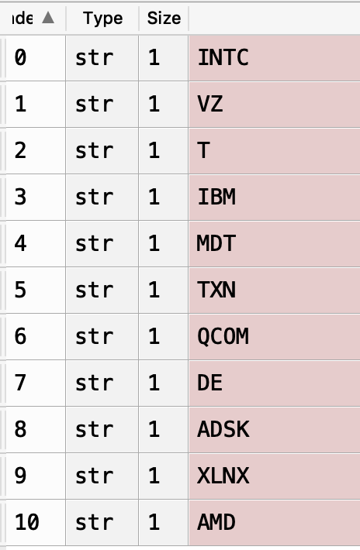
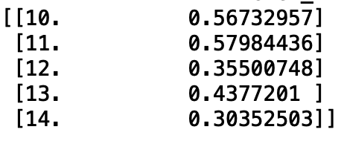
ETF Construction
Choose the stocks with correlation coefficient > 0.5 into ETF
Finalize ETF

Slide 9
Rolling Results Comparison
Yearly Rolling Result
Monthly Rolling Result
Longer Lag
Lower Transaction Cost
Shorter Lag
Higher Transaction Cost

Slide 10
Quarterly Rolling Results

Slide 11
Quarterly Rolling Weights

Slide 12
Investment Strategy for Client
Select stocks in ETF based on market Cap ranking and asset return correlation to Index
Adjust stock weights in ETF quarterly

Slide 13
Investment Strategy For Period 2

Slide 14
Investment Results For Period 2

Slide 15
2
RISK PARITY STRATEGY
ASSET SELECTION
RESULTS COMPARISON
CONDITIONAL FORCAST
CONSTRUCTION INSIGHTS

Slide 16
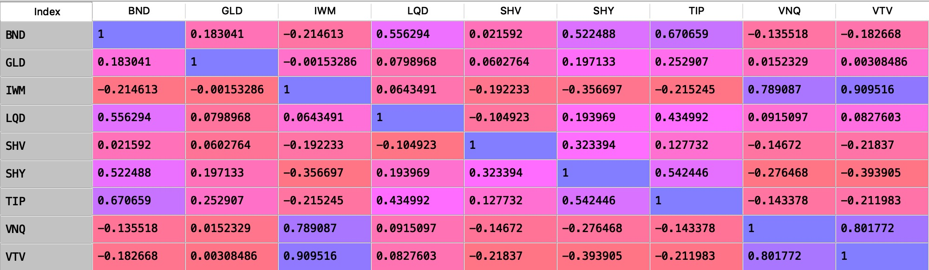
ASSET SELECTION
Asset type: Equity, Bond, Gold, Real Estate
Sharpe Ratio: VTV(value equity)-0.359882, IWM(Russell 2000)-0.346258
SHV(short T-bill)-1.14855, BND(bond market)-0.781256
GLD(gold)-0.214938
VNQ(real estate)-0.218863

Slide 17
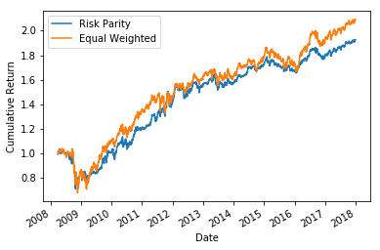
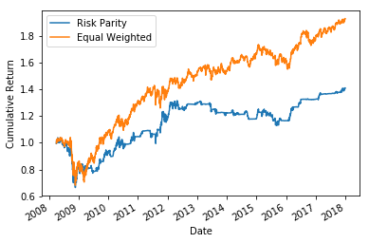
COMPARISON
Russell 2000
Russell 2000 & Short T-bill

Slide 18
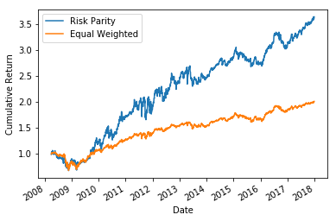
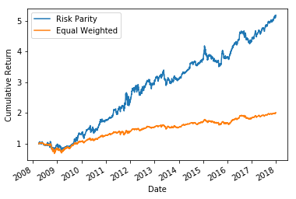
FINAL PORTFOLIO
Value Equity & Total Bond Market & Gold & Real Estate

Slide 19
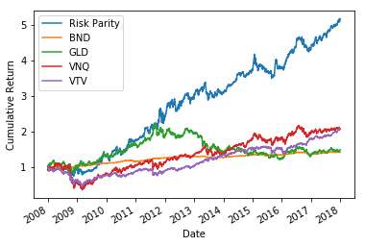
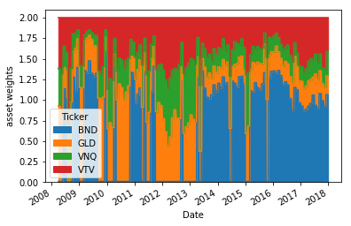
FINAL PORTFOLIO

Slide 20
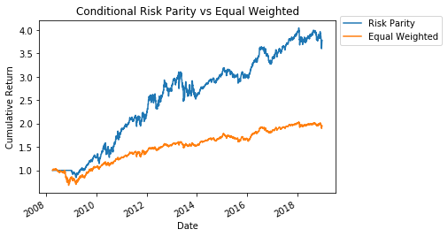
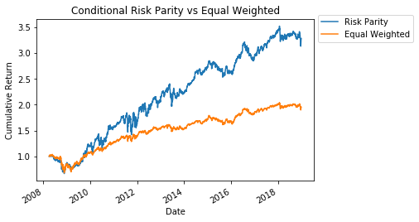
Conditional Method
Yearly
Monthly

Slide 21
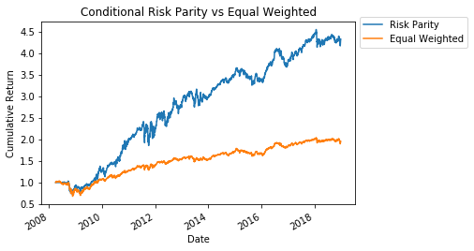
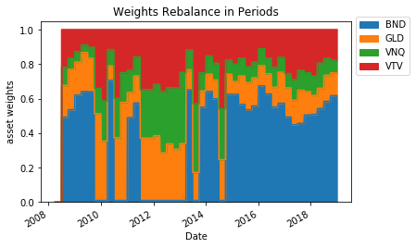
Quarterly Rolling Results

Slide 22
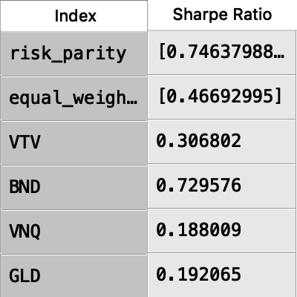
Sharpe Ratio

Slide 23
INSIGHTS FROM THE PROJECT
The rolling time frame is crucial for optimizing asset allocation and performance of risk parity strategy
1
Sharpe Ratio is not the only factor we should consider to construct risk parity portfolio
2
All weather strategy has a much more complicated structure
3

Slide 24
APPENDIX
Bond
Commodity
Real Estate
Equity

Slide 25
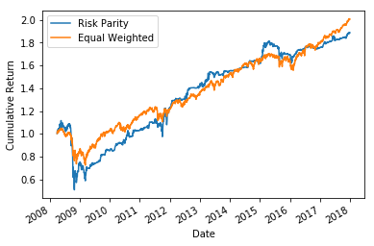
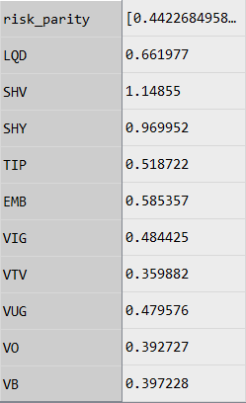
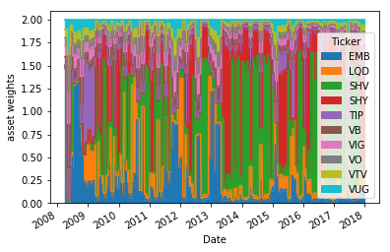
APPENDIX

Slide 26
Thanks For Listening

